Slide 1
Atlanta Housing Price Prediction
Chamonia Johnson, Tyler Thomas

Slide 2
Agenda
Problem Statement
Data Source
Data Preparation
Machine Learning Models
Evaluation
Recommendations
Q + A

Slide 3
Problem Statement
Our goal is to create a predictive pricing modeling tool where users can input listing, price, amenities, and other variables into our Machine Learning Model to predict the output price of a home in the Atlanta area.

Slide 4
Data Source
In order to predict the housing price of homes in Atlanta, we had to find a dataset with that information. Our original dataset includes real estate properties across the entire state of Georgia. Although this dataset contains listings that are in cities outside of Atlanta, it serves as a great starting point to manipulate the information we are looking for to create data models on our House Pricing Prediction.
Numpy, sklearn, pandas, and matplotlib are packages that we’ll be importing into Google Colab to conduct our analysis
Link: https://www.kaggle.com/datasets/yellowj4acket/real-estate-georgia/data

Slide 5
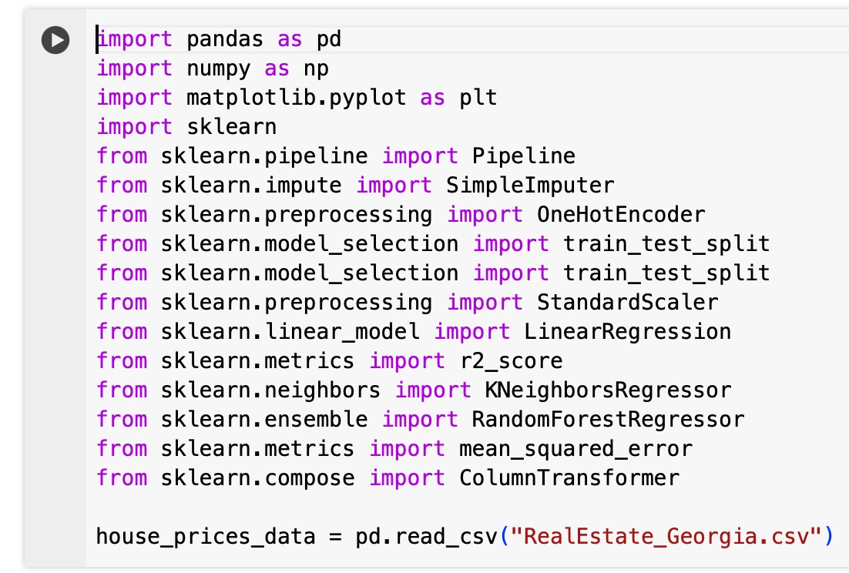
Data Preparation: Loading
In order for us to start our analysis, we’ll first import our packages and the dataset

Slide 6
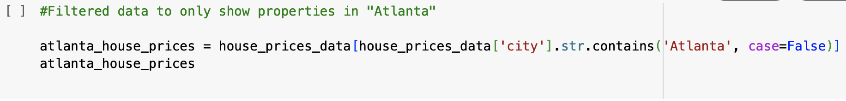
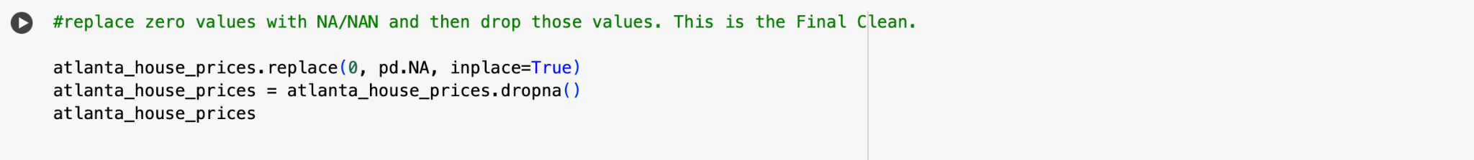
Data Preparation: Cleaning
We’ll now start cleaning the data by dropping listings that are not located in Atlanta
Next we’ll drop all of our unwanted columns that won’t be used in the analysis
The final step in the cleaning process is to replace 0 values as null and drop those observations

Slide 7
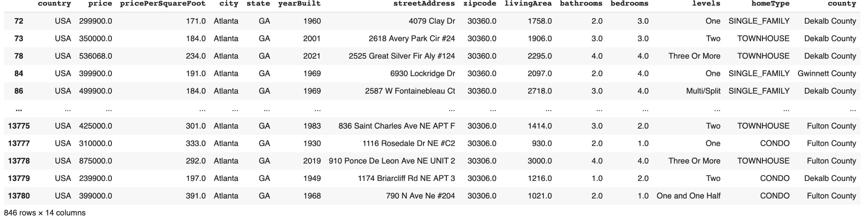

Slide 8
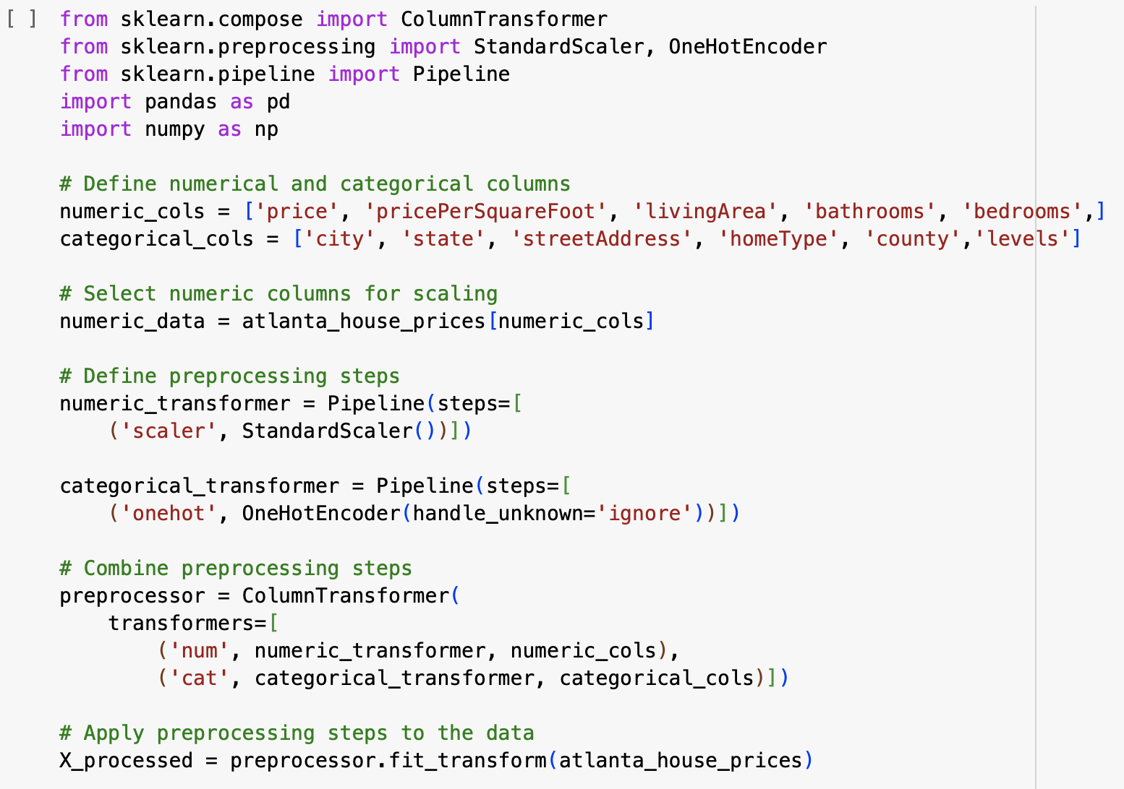
Data Preparation: Preprocessing
In this step, we want to make sure our numerical features are actual numerical data types (int, float), and our categorical features are objects (strings).

Slide 9
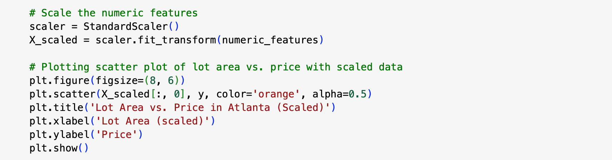
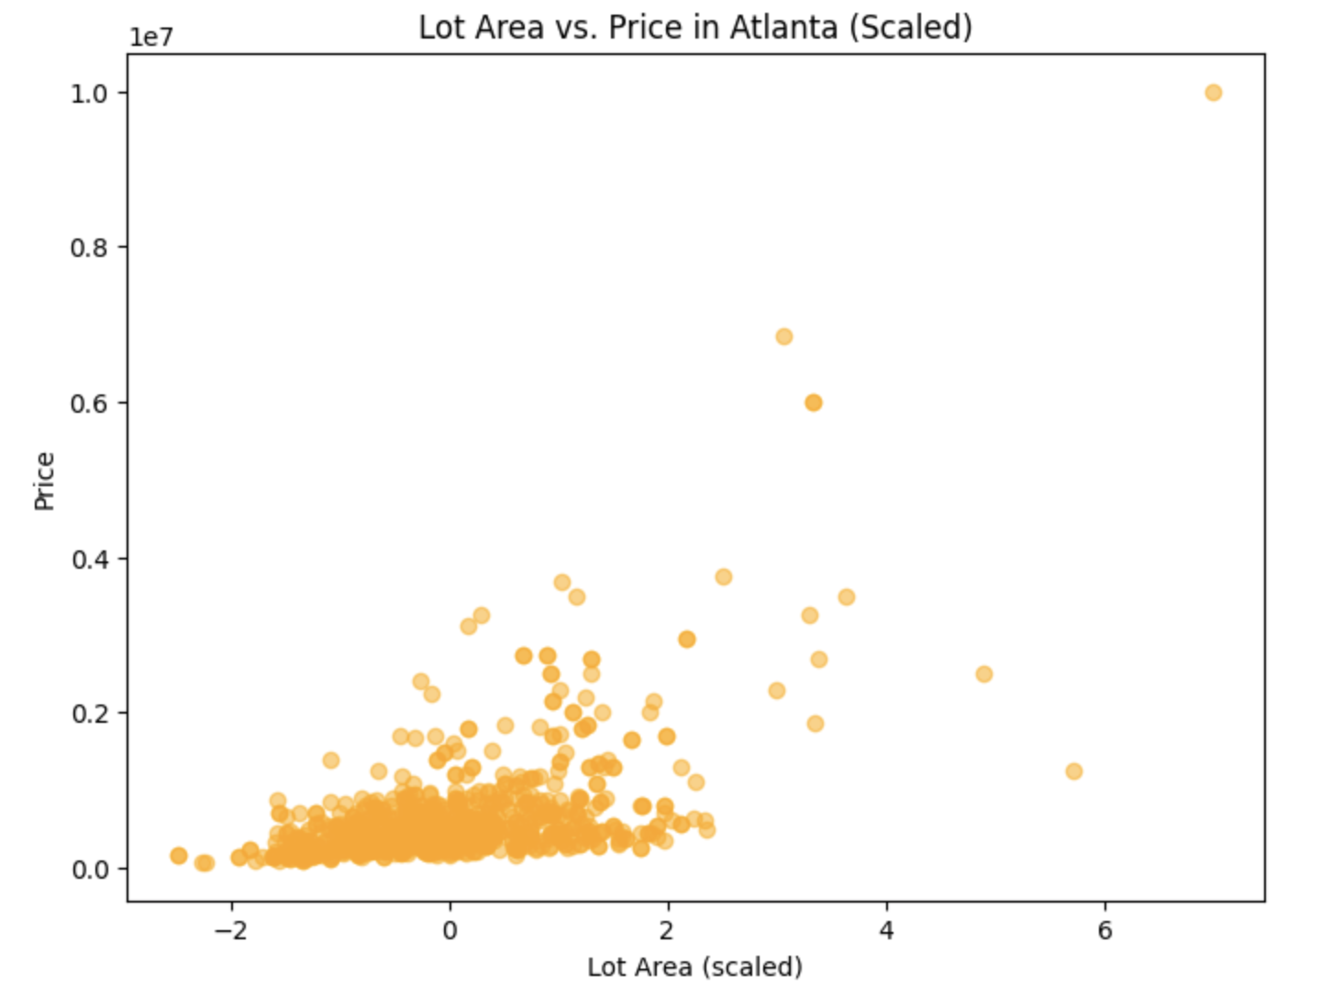
Data Preparation: Scaling

Slide 10
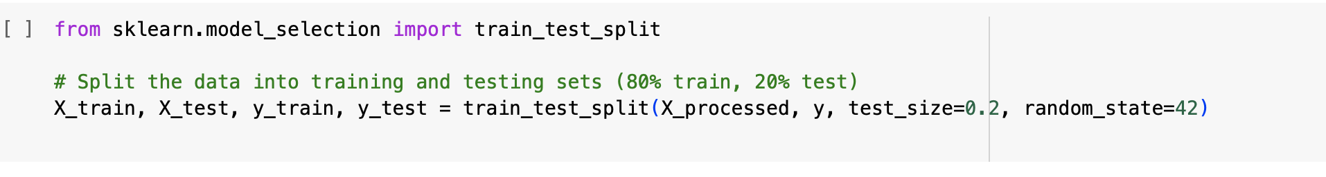
Data Preparation: Splitting

Slide 11
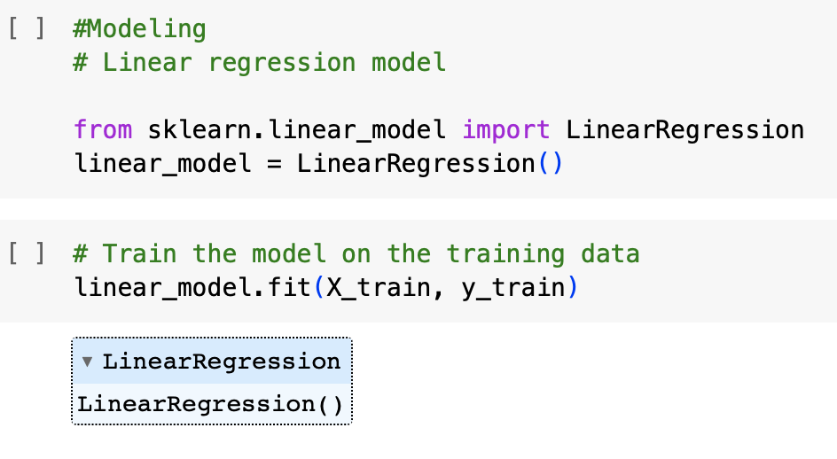
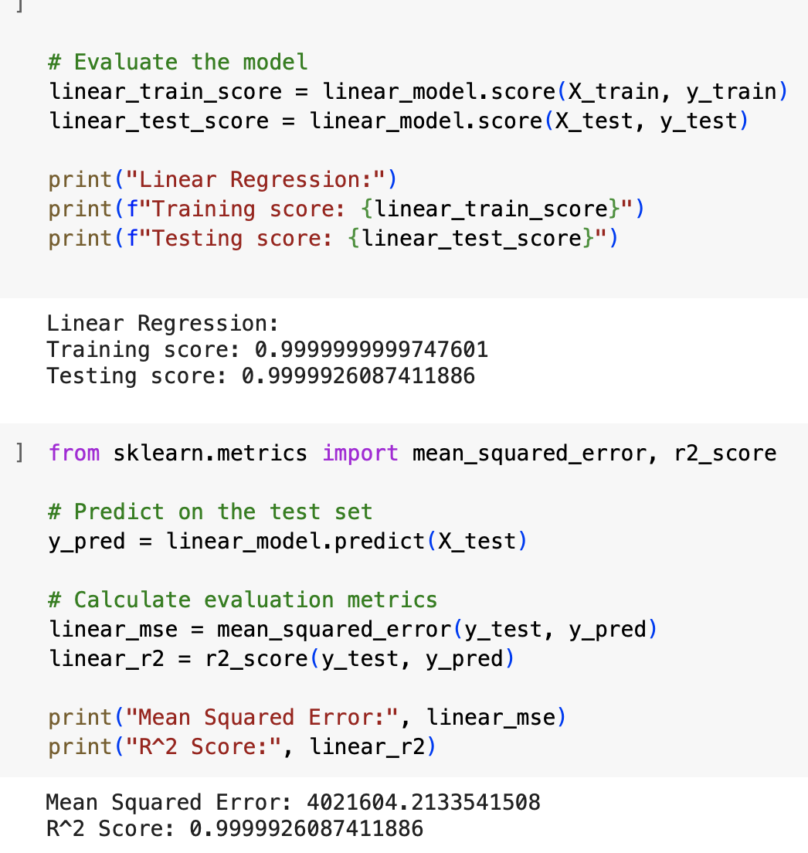
Machine Learning Model: Linear Regression

Slide 12
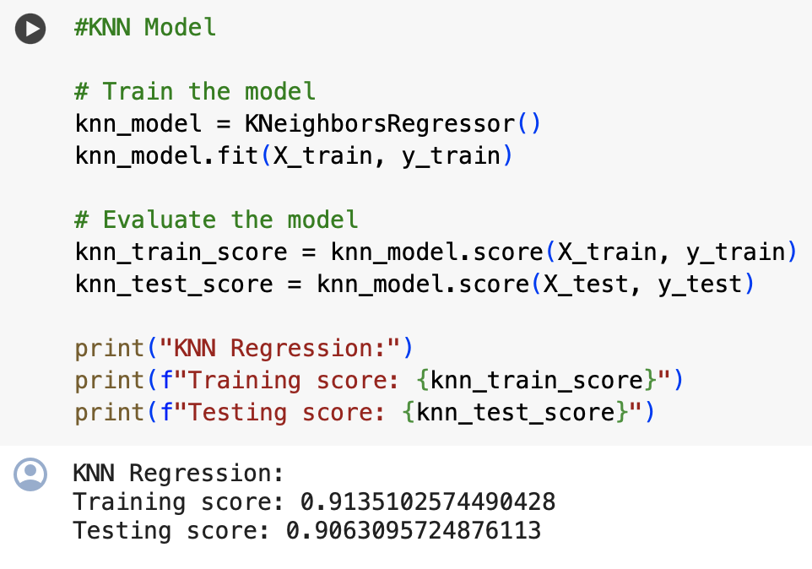
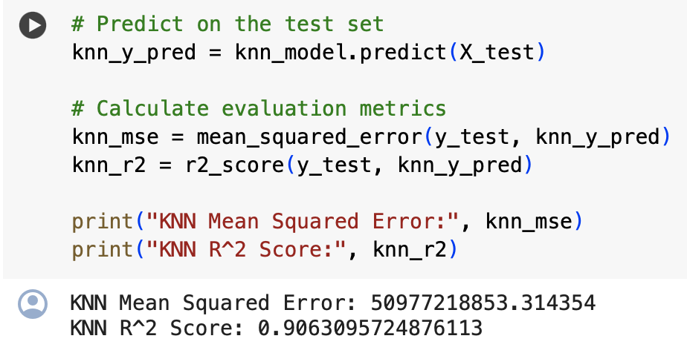
Machine Learning Model: KNN Regression

Slide 13
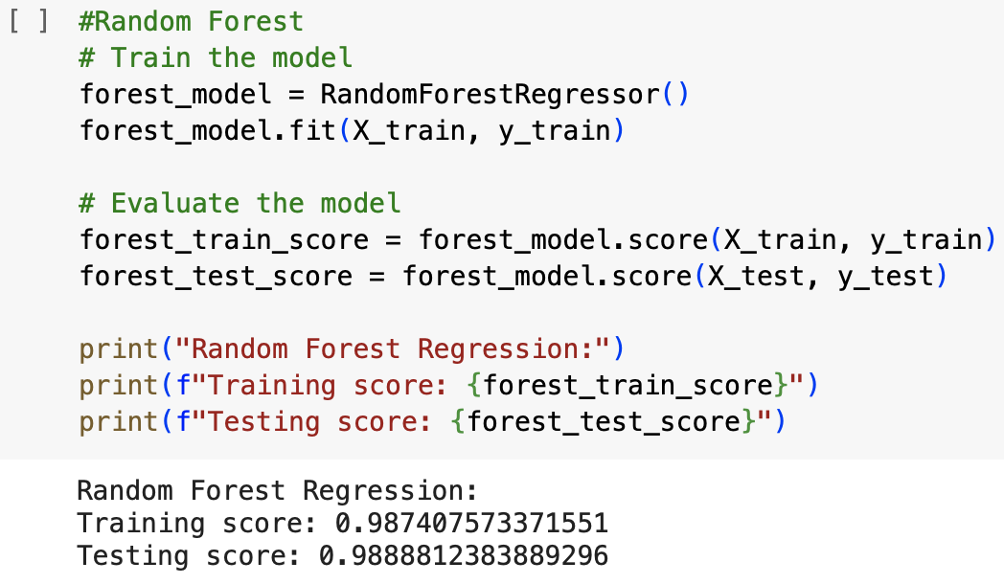
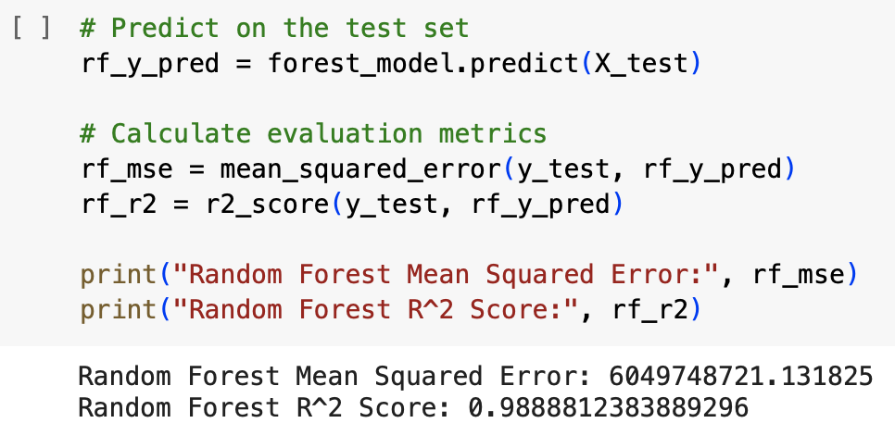
Machine Learning Model: Random Forest

Slide 14
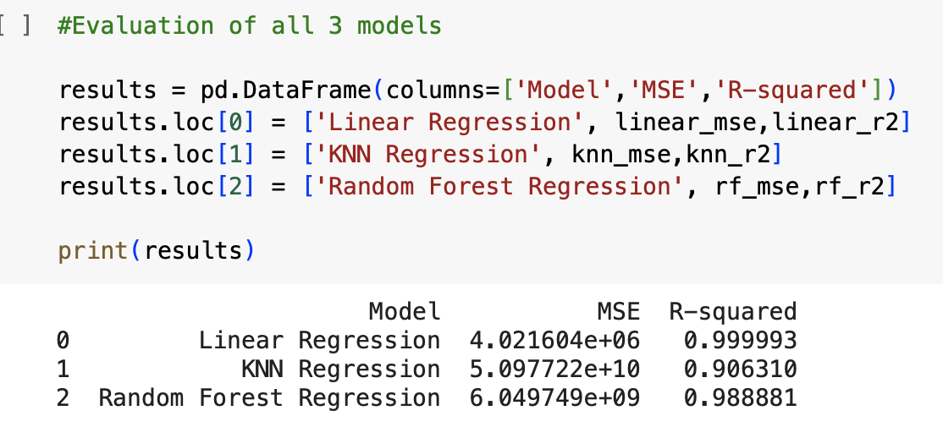
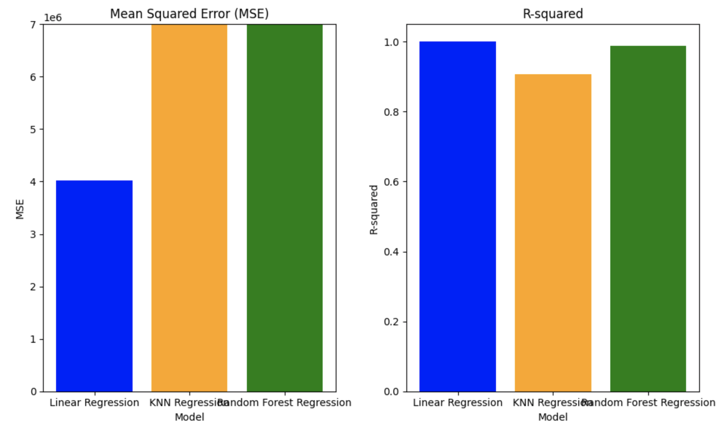
Evaluation

Slide 15
Recommendations
Based on our analysis, the Linear Regression model looks to be the best option as a pricing prediction model due to its lower MSE and higher R Squared compared to KNN and Random Forest Regression.

Slide 16
Q + A

